Slide 1
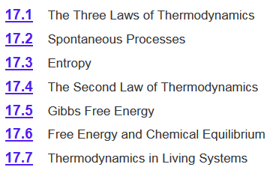
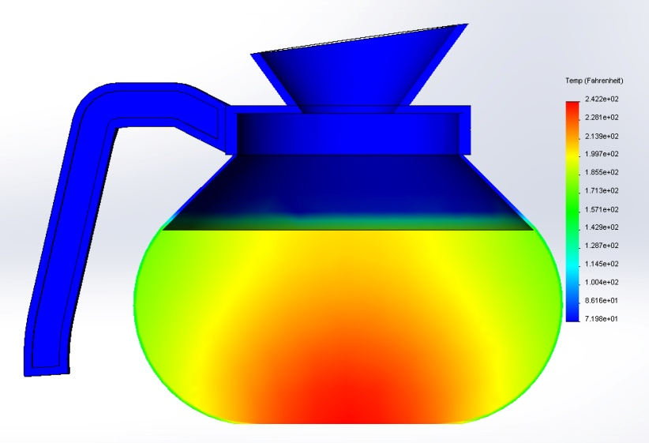
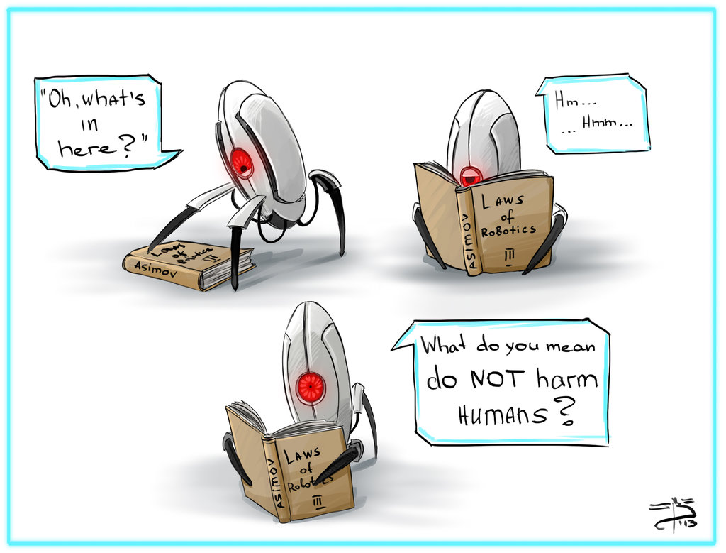
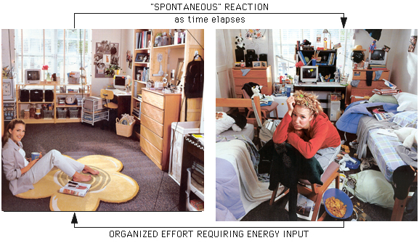
Chapter 17

Slide 2
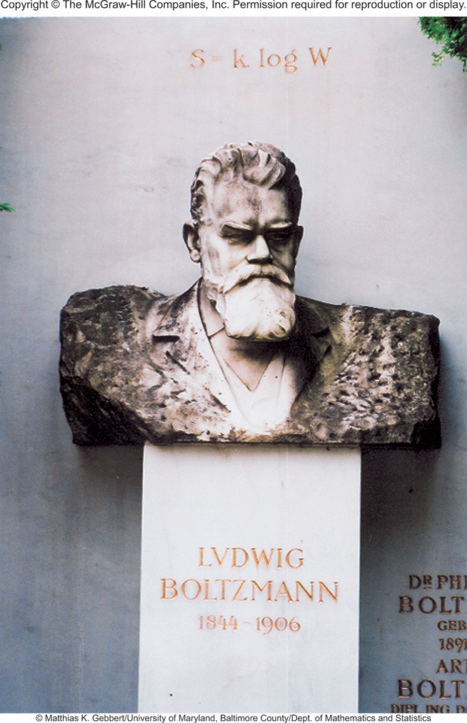
Microstates and Entropy
The Austrian physicist Ludwig Boltzmann introduced a model to relate the total number of microstates (the multiplicity, W) to entropy (S).
Boltzmann constant (k)
S = k ln W
k = 1.38 x 10⁻²³J/K
Gas constant
units on S is J/K
Avogadro constant
Boltzmann was the founding father of statistical mechanics, a completely new way of thinking about theoretical physics. His work was ridiculed by his fellow professors.

Slide 3
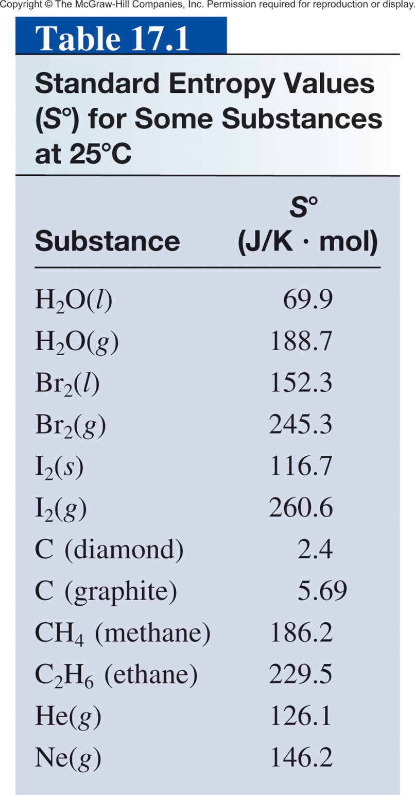
Standard Entropy
Difficult to count the number of microstates directly.
Measured by calorimetery.
Standard entropy (S°) absolute entropy of a substance at 1 atm (typically at 25°C)
Units of J K⁻¹ mol⁻¹
All positive values.
Absolute values (unlike ΔH which is relative)

Slide 4
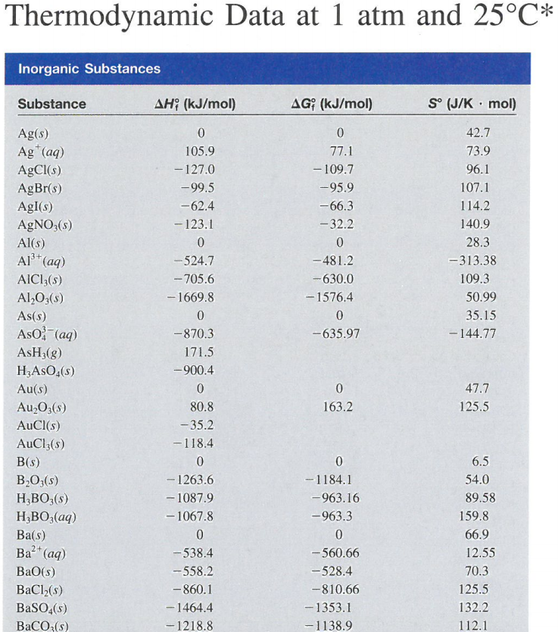
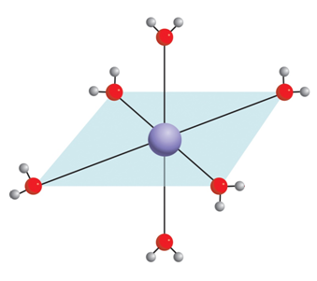
Why is there a –S?
S = k ln W
3+
2+
Al + 6H₂O Al(H₂O)₆ (aq)

Slide 5
Chapter 17

Slide 6
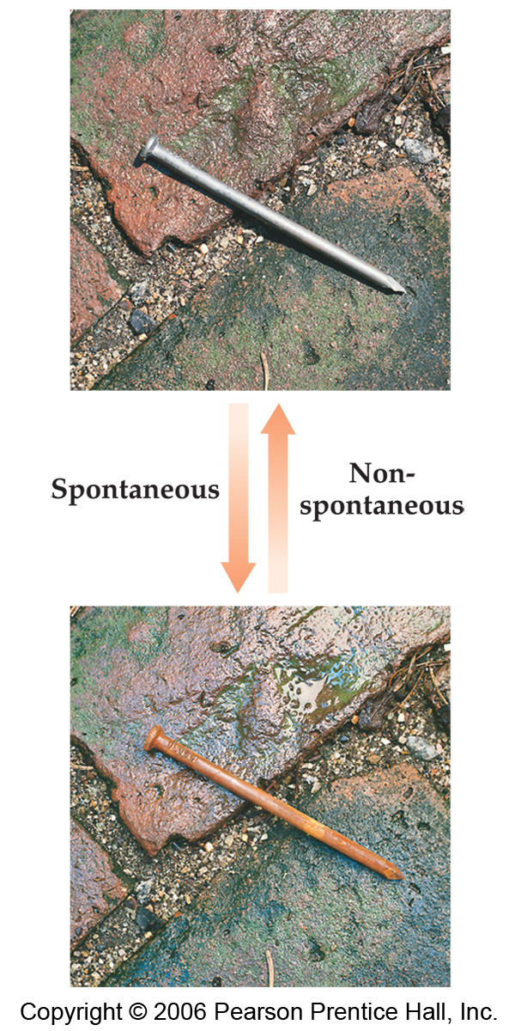
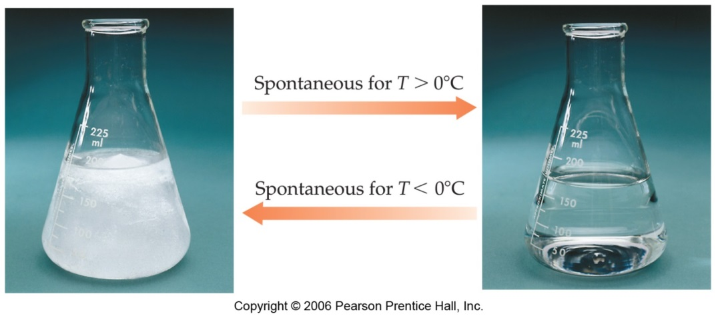
Spontaneity
Spontaneous: process that does occur under a specific set of conditions.
Nonspontaneous: process that does not occur under a specific set of conditions.
The reverse of a spontaneous process is a nonspontaneous one.
Spontaneity depends on temperature.

Slide 7
Predicting Spontaneity
If we mix reactants and products together will the reaction occur?
Enthalpy (H) is used to quantify the heat flow into or out of a system in a process that occurs at constant pressure.
ΔH_{rxn} = H_{products} – H_{reactants}
H_{products} < H_{reactants}
H_{products} > H_{reactants}
ΔH < 0
ΔH > 0
Exothermic
Endothermic
Enthalpically favorable
Enthalpically unfavorable
Not enough information. We need to know the change in entropy to predict if a reaction will spontaneously occur.

Slide 8
Predicting Spontaneity
If we mix reactants and products together will the reaction occur?
Entropy (S) Is a measure of the number of specific ways (microstates) in which a thermodynamic system may be arranged.
ΔS_{rxn} = S_{products} – S_{reactants}
S_{products} < S_{reactants}
S_{products} > S_{reactants}
ΔS < 0
ΔS > 0
Entropy decreases
Entropy increases
Entropically unfavorable
Entropically favorable
Still not enough information. We need to know total entropy change to predict if a reaction will spontaneously occur.

Slide 9
Predicting Spontaneity
If we mix reactants and products together will the reaction occur?
ΔS_{univ} = ΔS_{sys} + ΔS_{surr}
Equilibrium :
ΔS_{univ} = 0
Nonspontaneous process:
ΔS_{univ} < 0
Spontaneous process:
ΔS_{univ} > 0
If we know ΔS_{surr} we can calculate ΔS_{univ}
ΔS_{univ} = ΔS_{sys} + ΔS_{surr}
Can calculate from:
ΔS⁰
=
Σ
nS⁰(products)
-
Σ
mS⁰(reactants)
rxn

Slide 10
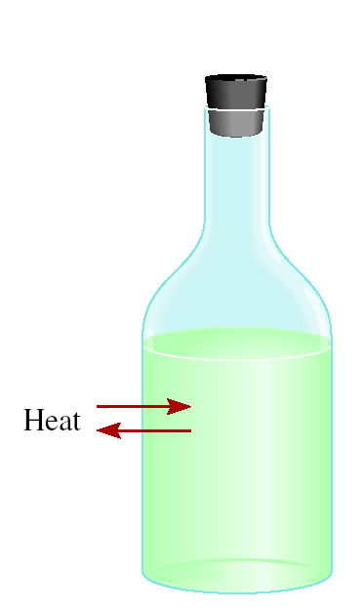
Predicting Spontaneity
If we know ΔS_{surr} we can calculate ΔS_{univ}
ΔS_{univ} = ΔS_{sys} + ΔS_{surr}
Can calculate from:
ΔS⁰
=
Σ
nS⁰(products)
-
Σ
mS⁰(reactants)
rxn
Surrounding = everything in the universe except the system.
surrounding
ΔS_{surr}
Very, very difficult to measure!
If not impossible.
system
ΔS⁰_{rxn}

Slide 11
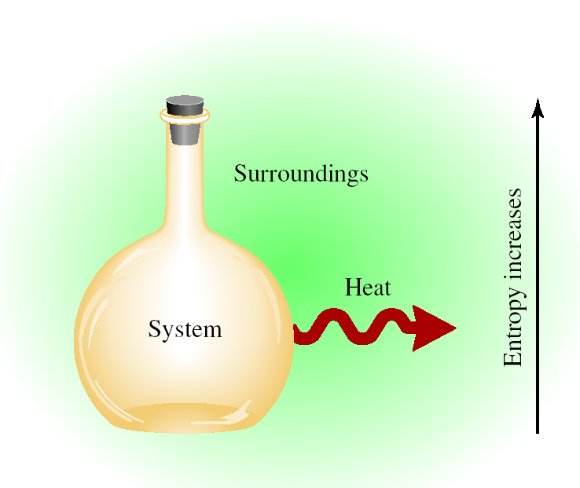
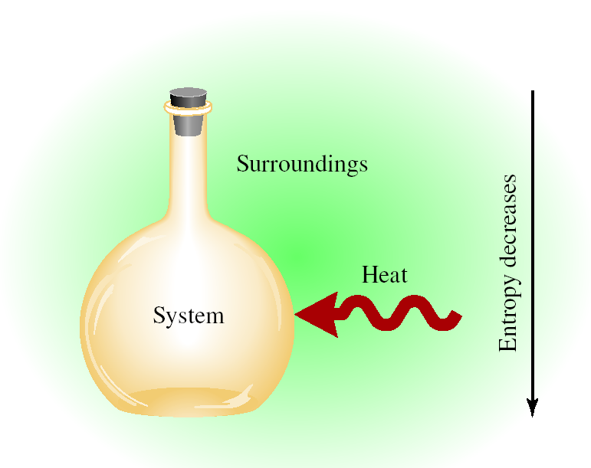
Heat and Entropy
Exothermic Reaction
Endothermic Process
−ΔH_{sys}
0 < ΔH_{sys}
+ΔH_{sys}
0 > ΔH_{sys}
Surroundings + heat = ↑ S
Surroundings - heat = ↓ S
ΔS_{surr} > 0
ΔS_{surr} < 0
ΔS_{surr} ∝ -ΔH_{sys}

Slide 12
Heat and Entropy
Heat released by the system increases the disorder of the surroundings.
ΔS_{surr} ∝ -ΔH_{sys}
The effect of -ΔH_{sys} on the surroundings depends on temperature:
  At high temperature, where there is already considerable disorder, the effect is muted
  At low temperature the effect is much more significant
  The difference between tossing a rock into a calm pool (low T) and a storm-tossed ocean (high T)
-ΔH_{sys}
ΔS_{surr} =
T

Slide 13
Predicting Spontaneity
ΔS_{univ} = ΔS_{sys} + ΔS_{surr}
-ΔH_{sys}
-ΔH_{sys}
ΔS_{surr} =
Substitution:
ΔS_{univ} = ΔS_{sys} +
T
T
Multiply by -T:
-TΔS_{univ} = -TΔS_{sys} + ΔH_{sys}
Rearrange:
-TΔS_{univ} = ΔH_{sys} - TΔS_{sys}
This equation relates ΔS_{univ} to ΔH_{sys} and ΔS_{sys}.
Both in terms of the system.

Slide 14
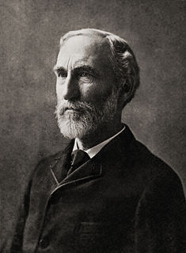
Gibbs Free Energy
-TΔS_{univ} = ΔH_{sys} - TΔS_{sys}
ΔG = ΔH_{sys} - TΔS_{sys}
in K
Gibbs free energy (ΔG)-
AKA Free energy.
Relates S, H and T of a system.
Can be used to predict spontaneity.
G is a state function.
Josiah Willard Gibbs (1839-1903)
First American Ph.D. in Engineering (Yale, 1863)
Praised by Albert Einstein as "the greatest mind in American history"
Died at 64 from an acute intestinal obstruction.

Slide 15
Gibbs Free Energy
For a constant temperature and constant pressure process:
-TΔS_{univ} = ΔH_{sys} - TΔS_{sys}
ΔG = ΔH_{sys} - TΔS_{sys}
Gibbs free energy (ΔG)- Can be used to predict spontaneity.
ΔG < 0 The reaction is spontaneous in the forward direction.
−ΔG = -T(+ΔS_{univ})
ΔS_{univ} > 0
ΔG > 0 The reaction is nonspontaneous as written. The
reaction is spontaneous in the reverse direction.
+ΔG = -T(-ΔS_{univ})
ΔS_{univ} < 0
ΔG = 0 The reaction is at equilibrium.
ΔG = -T(ΔS_{univ}) = 0
ΔS_{univ} = 0

Slide 16
Gibbs Free Energy
ΔG = ΔH - TΔS
If you know ΔG for reactants and products then you can calculate if a reaction is spontaneous.
If you know ΔG for two reaction then you can calculate if the sum is spontaneous.
If you know ΔS, ΔH and T then you can calculate spontaneity.
Can predict the temperature when a reaction becomes spontaneous.
If you have ΔH_{vap} or ΔH_{fus} and ΔS you can predict boiling and freezing points.
If you have ΔH_{vap} or ΔH_{fus} and T you can predict the entropy change during a phase change.
Can predict equilibrium shifts.

Slide 17
Standard Free Energy Changes
The standard free-energy of reaction (ΔG⁰ ) is the free-energy change for a reaction when it occurs under standard-state conditions.
rxn
aA + bB cC + dD
ΔG⁰
=
Σ
nΔG⁰ (products)
-
Σ
mΔG⁰ (reactants)
rxn
f
f
Standard free energy of formation (ΔG⁰) is the free-energy change that occurs when 1 mole of the compound is formed from its elements in their standard states.
f
ΔG⁰
cΔG⁰ (C)
dΔG⁰ (D)
-
aΔG⁰ (A)
bΔG⁰ (B)
=
[
+
]
[
+
]
rxn
f
f
f
f
ΔG⁰ of any element in its stable form is zero.
f

Slide 18
Standard Free Energy Changes
ΔG is a state function so free energy can be calculated from the table of standard values just as enthalpy and entropy changes.
aA + bB cC + dD
ΔG⁰
=
Σ
nΔG⁰ (products)
rxn
f
-
Σ
mΔG⁰ (reactants)
f
Standard free energy of formation (ΔG⁰) is the free-energy change that occurs when 1 mole of the compound is formed from its elements in their standard states.
f

Slide 19
Standard Free Energy Changes
Calculate the standard free-energy change for the following reaction:
2KClO₃(s) → 2KCl(s) + 3O₂(g)
ΔG⁰
=
Σ
nΔG⁰ (products)
-
Σ
mΔG⁰ (reactants)
rxn
f
f
ΔG⁰_{rxn} = [2(−408.3 kJ/mol) + 3(0)] − [2(−289.9 kJ/mol)]
ΔG⁰_{rxn} = −816.6 − (−579.8)
From appendix 3:
ΔG⁰_{rxn} = −236.8 kJ/mol
KClO₃(s) ΔG°_{f} = -289.9 kJ/mol
KCl(s) ΔG°_{f} = -408.3 kJ/mol
O₂(g) ΔG°_{f} = 0 kJ/mol
Is the reaction spontaneous?
ΔG⁰_{rxn} < 0 Yes!

Slide 20
17.4
Calculate the standard free-energy changes for the following reactions at 25°C.
CH₄(g) + 2O₂(g) CO₂(g) + 2H₂O(l)
ΔG°_{rxn} = [ΔG°_{f} (CO₂) + 2ΔG°_{f} (H₂O)] - [ΔG°_{f} (CH₄) + 2ΔG°_{f} (O₂)]
ΔG°_{rxn} =[(-394.4 kJ/mol) + (2)(-237.2 kJ/mol)] - [(-50.8 kJ/mol) + (2) (0 kJ/mol)]
ΔG°_{rxn} = -818.0 kJ/mol
From appendix 3:
Spontaneous?
Yes.
CH₄(g) ΔG°_{f} = -50.8 kJ/mol
O₂(g) ΔG°_{f} = 0 kJ/mol
CO₂(g) ΔG°_{f} = -394.4 kJ/mol
H₂O (l) ΔG°_{f} = -237.2 kJ/mol

Slide 21
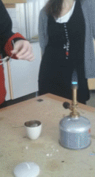
17.4
Calculate the standard free-energy changes for the following reactions at 25°C.
(b) 2MgO(s) 2Mg(s) + O₂(g)
ΔG°_{rxn} = [2ΔG°_{f} (Mg) + ΔG°_{f} (O₂)] - [2ΔG°_{f} (MgO)]
ΔG°_{rxn} = [(2)(0 kJ/mol) + (0 kJ/mol)] - [(2)(-569.6 kJ/mol)]
ΔG°_{rxn} = 1139 kJ/mol
From appendix 3:
Spontaneous?
No.
MgO(s) ΔG°_{f} = -569.6 kJ/mol
O₂(g) ΔG°_{f} = 0 kJ/mol
Mg(s) ΔG°_{f} = 0 kJ/mol
But the reverse is…
2Mg(s) + O₂(g) 2MgO(s)

Slide 22
More ΔG° Calculations
Appendix 3
ΔG⁰
=
Σ
nΔG⁰ (products)
rxn
f
-
Σ
mΔG⁰ (reactants)
f
To predict spontaneity of any rxn:
Pick any reactants and products.
Write a balanced equation.
Calculate ΔG⁰_{rxn}.
Is the reaction spontaneous?

Slide 23
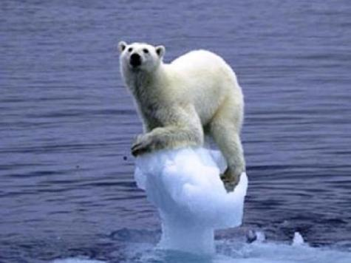
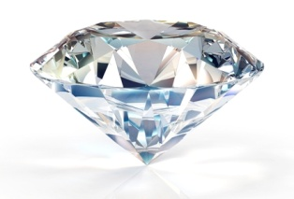
Another Example
C(s, diamond) + O₂(g) CO₂(g)
ΔG°_{rxn} = [ΔG°_{f} (CO₂)] - [ΔG°_{f} (C, diamond) + ΔG°_{f} (O₂)]
From appendix 3:
ΔG°_{rxn} = -396.4 kJ
C, diamond(s) ΔG°_{f} = 2.9 kJ/mol
O₂(g) ΔG°_{f} = 0 kJ/mol
CO₂(g) ΔG°_{f} = -394.4 kJ/mol
+ O₂
Therefore, diamonds are contributing to global warming!
very slowly

Slide 24

More ΔG° Calculations
Similar to ΔH°, one can use the ΔG° for various reactions to determine ΔG° for the reaction of interest (a “Hess’ Law” for ΔG°)
Hess’ Law- states that regardless of the multiple stages or steps of a reaction, the total enthalpy change for the reaction is the sum of all changes.
What is the ΔG° for this reaction:
Given:
C(s, diamond) + O₂(g) CO₂(g) ΔG° = -397 kJ
C(s, graphite) + O₂(g) CO₂(g) ΔG° = -394 kJ

Slide 25
More ΔG° Calculations
What is the ΔG° for this reaction:
Given:
C(s, diamond) + O₂(g) CO₂(g) ΔG° = -397 kJ
C(s, graphite) + O₂(g) CO₂(g) ΔG° = -394 kJ
CO₂(g) C(s, graphite) + O₂(g) ΔG° = +394 kJ
C(s, diamond) + O₂(g) CO₂(g) ΔG° = -397 kJ
CO₂(g) C(s, graphite) + O₂(g) ΔG° = +394 kJ
C(s, diamond) C(s, graphite) ΔG° = -3 kJ
ΔG°_{rxn} < 0…..rxn is spontaneous

Slide 26
Alternative ΔG Calculation
Is the following reaction spontaneous at 298 K? (assume standard conditions)
Given:
 | ΔH°_{f} (kJ/mol) | S° (J/mol.K)
KClO₃(s) | -397.7 | 143.1
KClO₄(s) | -432.8 | 151.0
KCl (s) | -436.7 | 82.6
Given
ΔG°_{rxn} = ΔH°_{rxn} - TΔS°_{rxn}
Then Find
First Calculate

Slide 27
Alternative ΔG Calculation
 | ΔH°_{f} (kJ/mol) | S° (J/mol.K)
KClO₃(s) | -397.7 | 143.1
KClO₄(s) | -432.8 | 151.0
KCl (s) | -436.7 | 82.6

Slide 28
Alternative ΔG Calculation
 | ΔH°_{f} (kJ/mol) | S° (J/mol.K)
KClO₃(s) | -397.7 | 143.1
KClO₄(s) | -432.8 | 151.0
KCl (s) | -436.7 | 82.6
ΔH°_{rxn} = -144 kJ
ΔS°_{rxn} = -36.8 J/K
Enthalpically favorable
Entropically unfavorable
What about at 5000 K?
(Assuming the same ΔH and S)
ΔG°_{rxn} = 50 kJ
ΔG°_{rxn} > 0…rxn is nonspontaneous at 5000 K
ΔG°_{rxn} < 0…..rxn is spontaneous at 298 K

Slide 29
ΔG Temperature Dependence
ΔG°_{rxn} = -133 kJ at 298 K
Spontaneous
ΔG°_{rxn} = 50 kJ at 5000 K
Nonspontaneous
Reaction spontaneity is a temperature dependent phenomenon!
ΔG_{rxn} = ΔH_{rxn} - TΔS_{rxn}

Slide 30
ΔG Temperature Dependence
Enthalpy:
ΔH_{rxn} < 0 The reaction is enthalpically favorable.
Entropy:
ΔS_{rxn} > 0 The reaction is entropically favorable.
Need both to predict spontaneity. And sometimes temperature!
ΔG < 0 Spontaneous
ΔG = ΔH - TΔS
ΔG > 0 Nonspontaneous
ΔG = 0 Equilibrium
1) If ΔH < 0 and ΔS > 0, then ΔG is negative at all T
2) If ΔH > 0 and ΔS > 0, then ΔG depends on T
3) If ΔH < 0 and ΔS < 0, then ΔG depends on T
4) If ΔH > 0 and ΔS < 0, then ΔG is positive at all T

Slide 31
ΔG Temperature Dependence
ΔG < 0 Spontaneous
ΔG = ΔH - TΔS
ΔG > 0 Nonspontaneous
ΔG = 0 Equilibrium
3) ΔH < 0 and ΔS < 0
(Enthalpically favorable, entropically unfavorable)
If ΔH < TΔS, then ΔG is positive.
If ΔH > TΔS, then ΔG is negative.
Nonspontaneous at high T
Spontaneous at low T
(Enthalpically unfavorable, entropically favorable)
2) ΔH > 0 and ΔS > 0
If ΔH < TΔS, then ΔG is negative.
If ΔH > TΔS, then ΔG is positive.
Spontaneous at high T
Nonspontaneous at low T

Slide 32
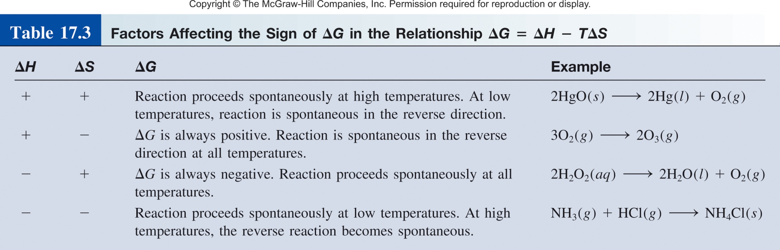
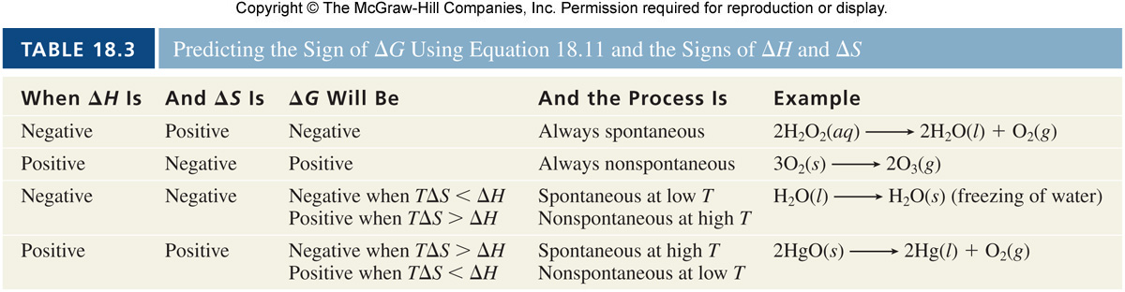
ΔG Temperature Dependence
ΔG = ΔH - TΔS

Slide 33
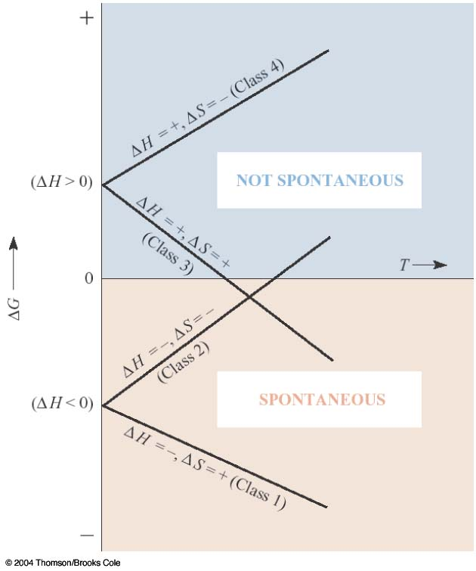
ΔG Temperature Dependence
  Four possible scenarios:
  (1) ΔH < 0, ΔS > 0
  (2) ΔH > 0, ΔS > 0
  (3) ΔH < 0, ΔS < 0
  (4) ΔH > 0, ΔS < 0
Nonspontaneous
Spontaneous

Slide 34
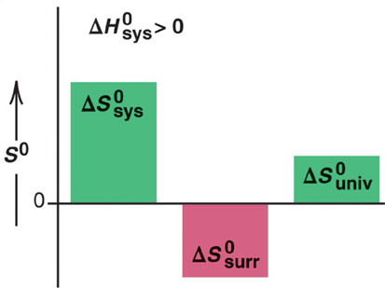
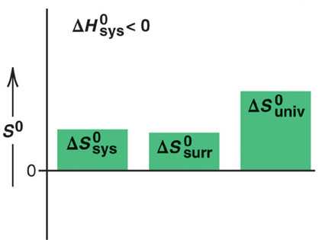
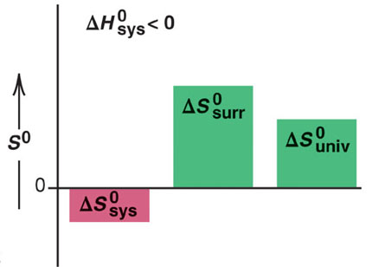
ΔS_{univ} and Spontaneous Reactions
ΔG = ΔH - TΔS
Class 1:
Class 3:
endothermic
exothermic
system becomes more disordered
system becomes more disordered
Class 2:
exothermic
system becomes more ordered

Slide 35
Predicting T from Gibbs Equation
ΔG°_{rxn} = -133 kJ at 298 K
Spontaneous
ΔG°_{rxn} = 50 kJ at 5000 K
Nonspontaneous
Reaction spontaneity is a temperature dependent phenomenon!
At what temperature will the reaction become spontaneous?
Find T where ΔG changes from positive to negative.
I.e. when ΔG =0.
ΔG = ΔH – TΔS = 0
T = ΔH/ΔS

Slide 36
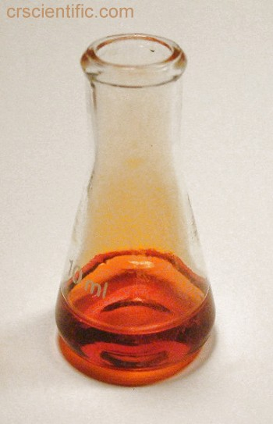
Predicting T from Gibbs Equation
At what T is the following reaction spontaneous?
Br₂(l) Br₂(g)
Given: ΔH°= 30.91 kJ/mol
ΔS°= 93.2 J/mol.K
ΔG = ΔH – TΔS = 0
T = ΔH/ΔS
  ΔH > 0, ΔS > 0
  The reaction will be spontaneous when T > 331.7 K
T = (30.91 kJ/mol) /(93.2 J/mol.K)
T = 331.7 K

Slide 37
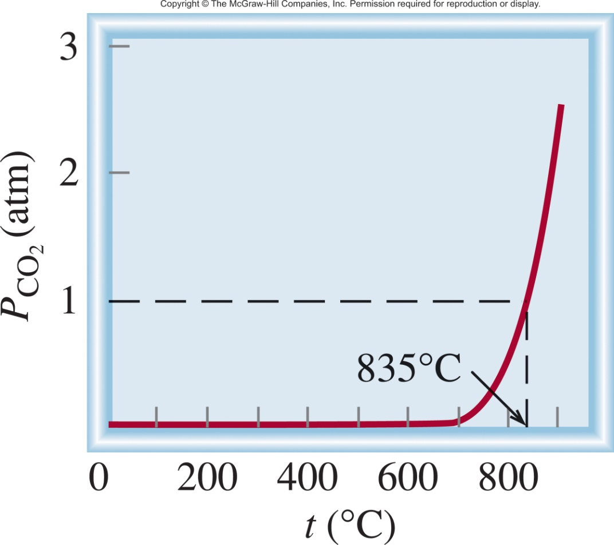
Predicting T from Gibbs Equation
At what T is the following reaction spontaneous?
CaCO₃ (s) CaO (s) + CO₂ (g)
ΔG⁰ = ΔH⁰ – TΔS⁰ = 0
Equilibrium Pressure of CO₂
T = Δ⁰H/ΔS⁰
ΔH⁰ = 177.8 kJ/mol
ΔS⁰ = 160.5 J/K·mol
ΔG⁰ = 0 at 835 ºC

Slide 38
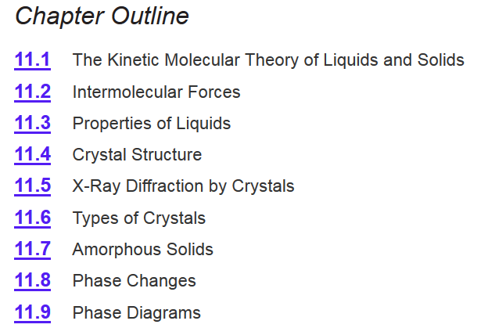
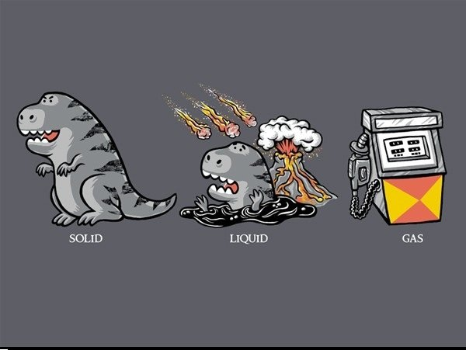
Chapter 11

Slide 39
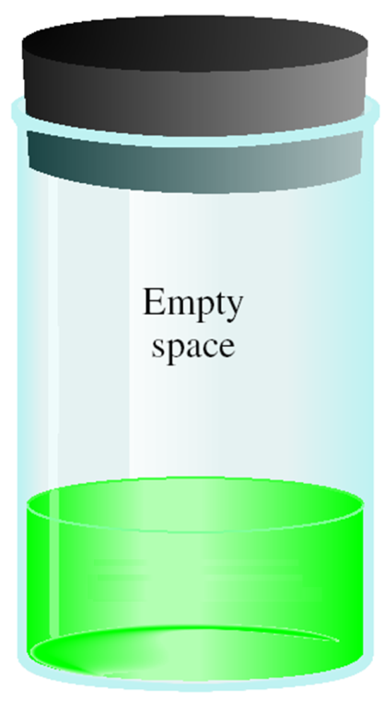

Liquid ↔ Gas
Liquid
At time = 0
At time > 0
At time = ∞
At equilibrium!
ΔG < 0 Spontaneous
# of molecules in =
# of molecules out
ΔG = ΔH - TΔS
ΔG > 0 Nonspontaneous
ΔG = 0 Equilibrium
rate of evaporation =
rate of condensation

Slide 40
Gibbs Equation and Phase Change
H₂O (l) H₂O (g)
Molar heat of vaporization (ΔH_{vap}) is the energy required to vaporize 1 mole of a liquid at its boiling point.
If we know ΔH_{vap} and boiling point we can calculate ΔS!
ΔH
ΔG
= ΔH – TΔS
= 0
ΔS =
T
ΔH_{vap} = 40.79 kJ/mol
BP(H₂O) = 373 K
40.79 kJ/mol
ΔS
=
373 K

Slide 41
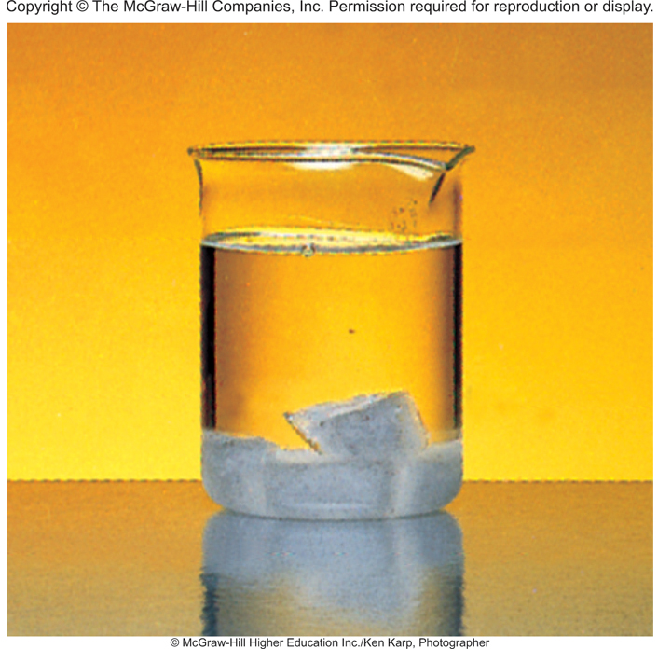
17.5
The molar heats of fusion and vaporization of benzene are
10.9 kJ/mol and 31.0 kJ/mol, respectively. Calculate the entropy changes for the solid → liquid and liquid → vapor transitions for benzene. At 1 atm pressure, benzene melts at 5.5°C and boils at 80.1°C.
vapor
liquid
solid

Slide 42
17.5
The molar heats of fusion and vaporization of benzene are
10.9 kJ/mol and 31.0 kJ/mol, respectively. Calculate the entropy changes for the solid → liquid and liquid → vapor transitions for benzene. At 1 atm pressure, benzene melts at 5.5°C and boils at 80.1°C.
solid → liquid → vapor
ΔH_{fus}
ΔH_{vap}
Molar heat of vaporization (ΔH_{vap}) is the energy required to vaporize 1 mole of liquid to gas.
Molar heat of fusion (ΔH_{fus}) is the energy required to melt 1 mole of solid.

Slide 43
17.5
The molar heats of fusion and vaporization of benzene are
10.9 kJ/mol and 31.0 kJ/mol, respectively. Calculate the entropy changes for the solid → liquid and liquid → vapor transitions for benzene. At 1 atm pressure, benzene melts at 5.5°C and boils at 80.1°C.
solid → liquid → vapor
ΔH_{fus}
ΔH_{vap}
ΔH
ΔG
= ΔH – TΔS
= 0
ΔS =
T

Slide 44
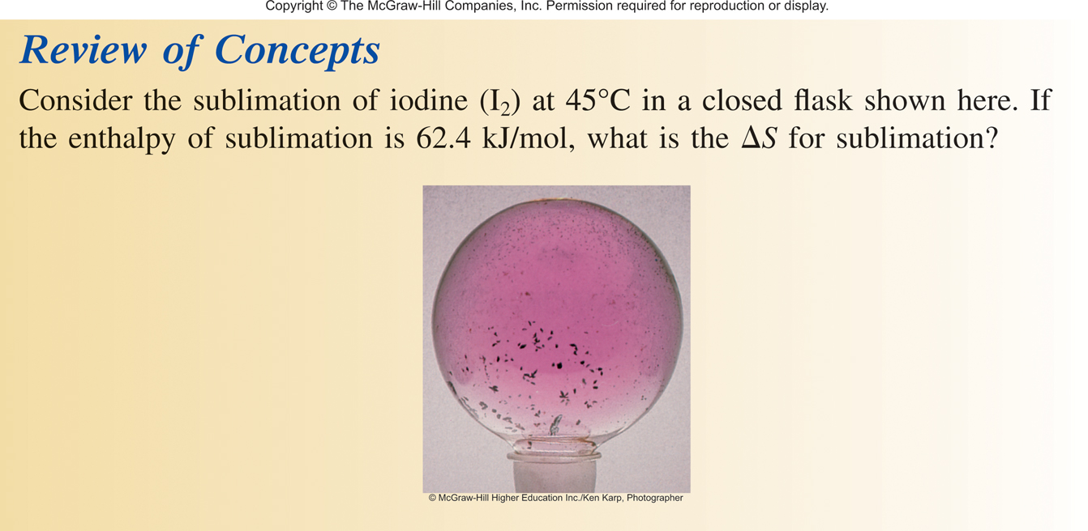

Slide 45
Chapter 17

